Slide 1

Flocculation Models

Slide 2
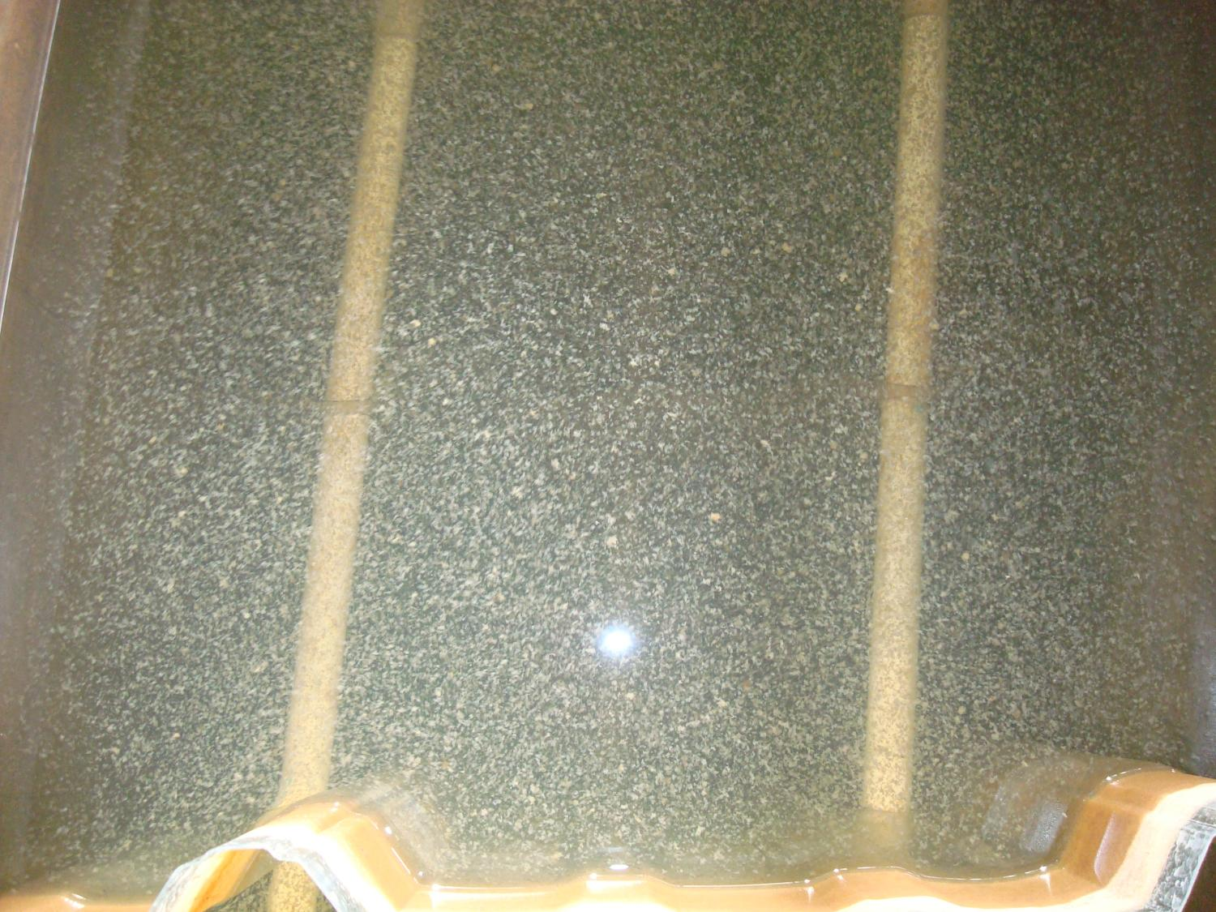

Slide 3
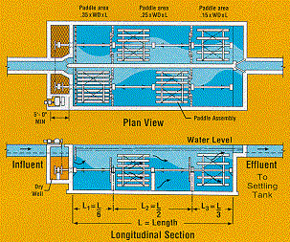
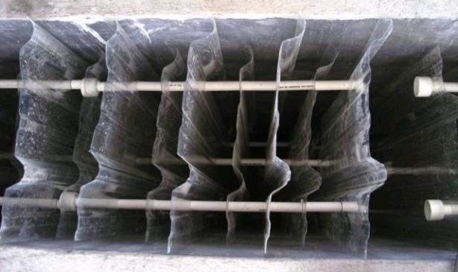
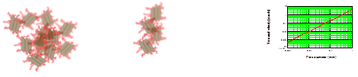
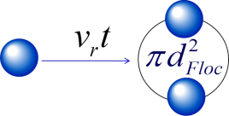
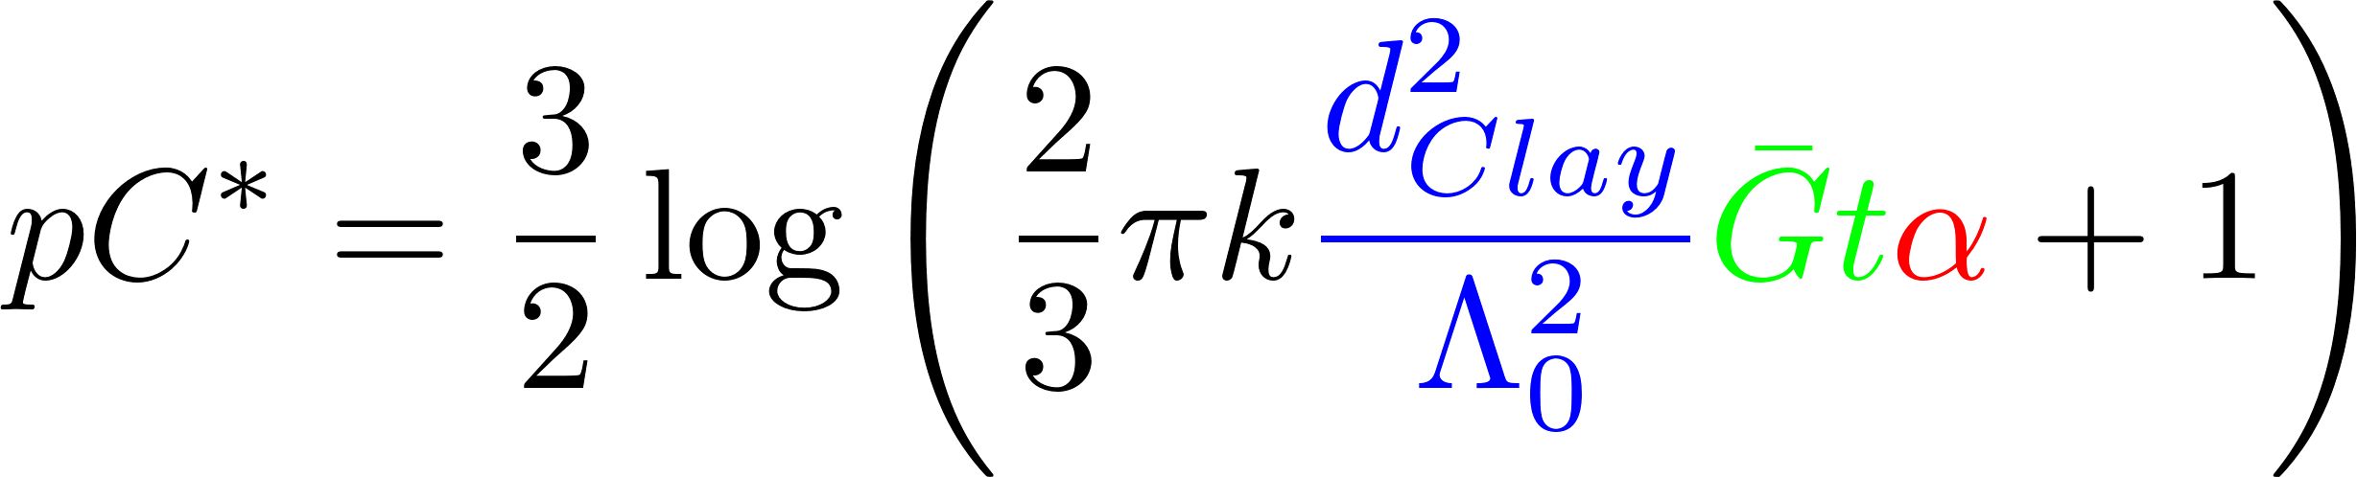
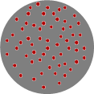
Overview
Flocculation definition and regulation
Mechanical Design
Hydraulic conventional design
Fractals
Collisions
Predictive model
Conclusions
Surface coverage

Slide 4
What is Flocculation?
A process that transforms a turbid suspension of tiny particles into a turbid suspension of big particles!
Requires
Sticky particles (splattered with adhesive nanoparticles)
Successful collisions between particles
Flocs are fractals (“the same from near as from far”)
The goal of flocculation is to reduce the number of small particles (that haven’t been flocculated)
One goal is to understand why some particles are always left behind (turbidity after sedimentation)
Another goal is to learn how to design a flocculator
Notes:
What does successful mean?

Slide 5
The Challenge of Flocculation
We would like to know
How do particles make contact to aggregate?
What determines the time required for two flocs to collide? (flocculation rate)
How would you design a flocculator for a target settled water turbidity?
How strong are flocs?
The challenge of the large changes in scale
The Al(OH)₃ nanoparticles begin at a scale of 10 to 100 nanometers
Flocs end at a scale of 100 micrometers
Flocculators are meters long
Notes:
5

Slide 6
Ten State Standards
http://10statesstandards.com/waterrev2012.pdf
The detention time for floc formation should be at least 30 minutes with consideration to using tapered (i.e., diminishing velocity gradient) flocculation. The flow‑through velocity should be not less than 0.5 nor greater than 1.5 feet per minute.
Agitators shall be driven by variable speed drives with the peripheral speed of paddles ranging from 0.5 to 3.0 feet per second. External, non-submerged motors are preferred.
Flocculation and sedimentation basins shall be as close together as possible. The velocity of flocculated water through pipes or conduits to settling basins shall be not less than 0.5 nor greater than 1.5 feet per second. Allowances must be made to minimize turbulence at bends and changes in direction.
Baffling may be used to provide for flocculation in small plants only after consultation with the reviewing authority. The design should be such that the velocities and flows noted above will be maintained.
Hydraulic flocculators allowed only by special permission!

Slide 7
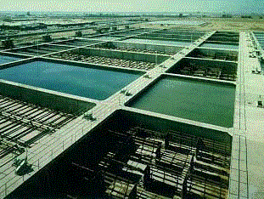
Mechanical Flocculation
Particle collisions caused by gentle stirring
Advantage
energy dissipation rate can be varied independent of flow rate
Disadvantage
potential short circuiting (some fluid moves quickly from inlet to outlet)
moving parts in a wet environment
Highly nonuniform energy dissipation rate

Slide 8
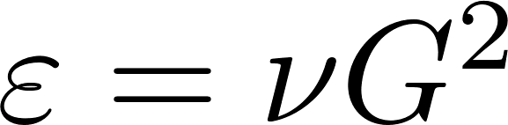
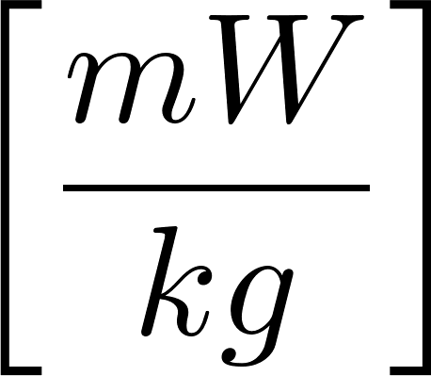
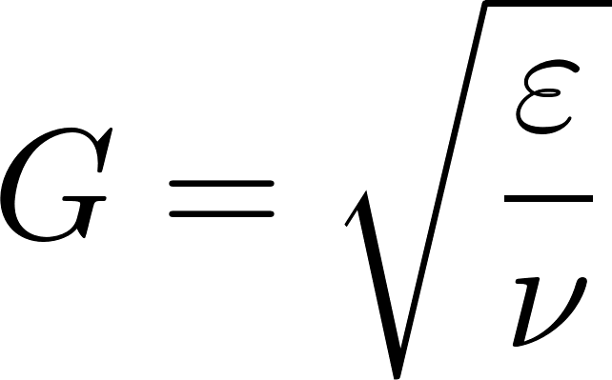
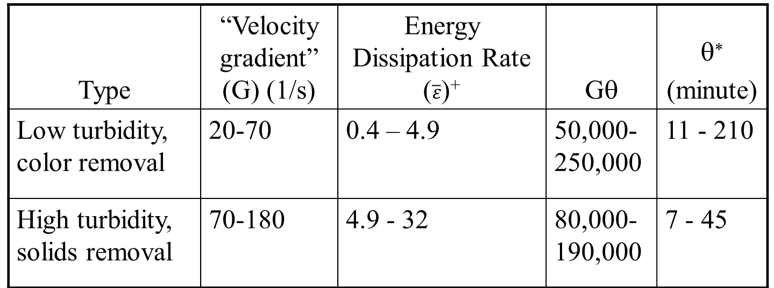
Recommended G and Gθ values: Turbidity or Color Removal (Mechanical flocculators)
Type | “Velocity gradient” (G) (1/s) | Energy Dissipation Rate ($\overline{ε}$)⁺ | Gθ | θ∗ (minute)
Low turbidity, color removal | 20-70 | 0.4 – 4.9 | 50,000-250,000 | 11 - 210
High turbidity, solids removal | 70-180 | 4.9 - 32 | 80,000-190,000 | 7 - 45
* Calculated based on G and Gθ guidelines
⁺ average value assuming viscosity is 1 mm²/s
Sincero and Sincero, 1996 Environmental Engineering: A Design Approach
Notes:
Cleasby, J. L., "Is Velocity Gradient a Valid Turbulent Flocculation Parameter?"
ASCE, Journal of Environmental Engineering, Vol. 110, No. 5, Oct.,
1984
http://dx.doi.org/10.1061/(ASCE)0733-9372(1984)110:5(875)

Slide 9
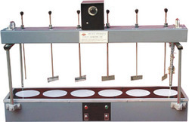
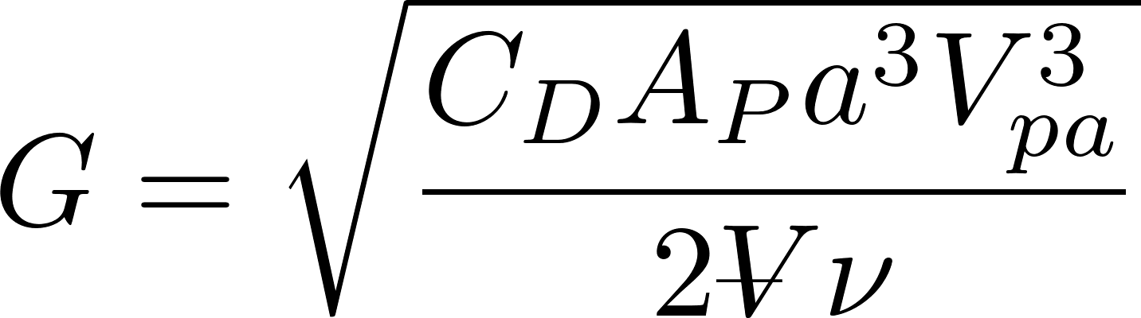
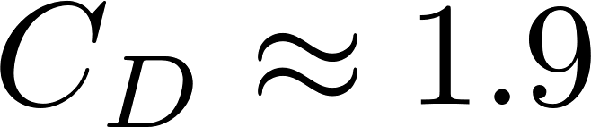
Mechanical Design: mixing with paddles
extra
Ratio of relative to absolute velocity of paddles
Projected area of paddles
Drag coefficient
“velocity gradient”
Reactor volume

Slide 10
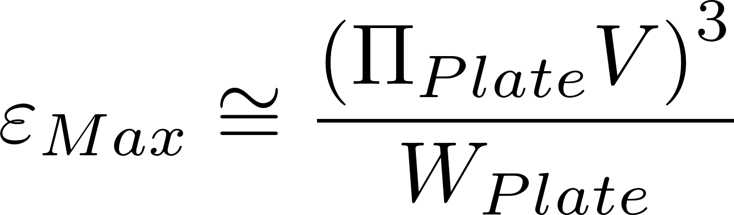
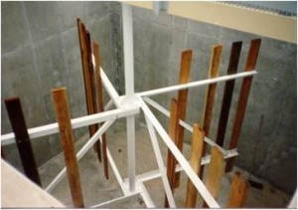
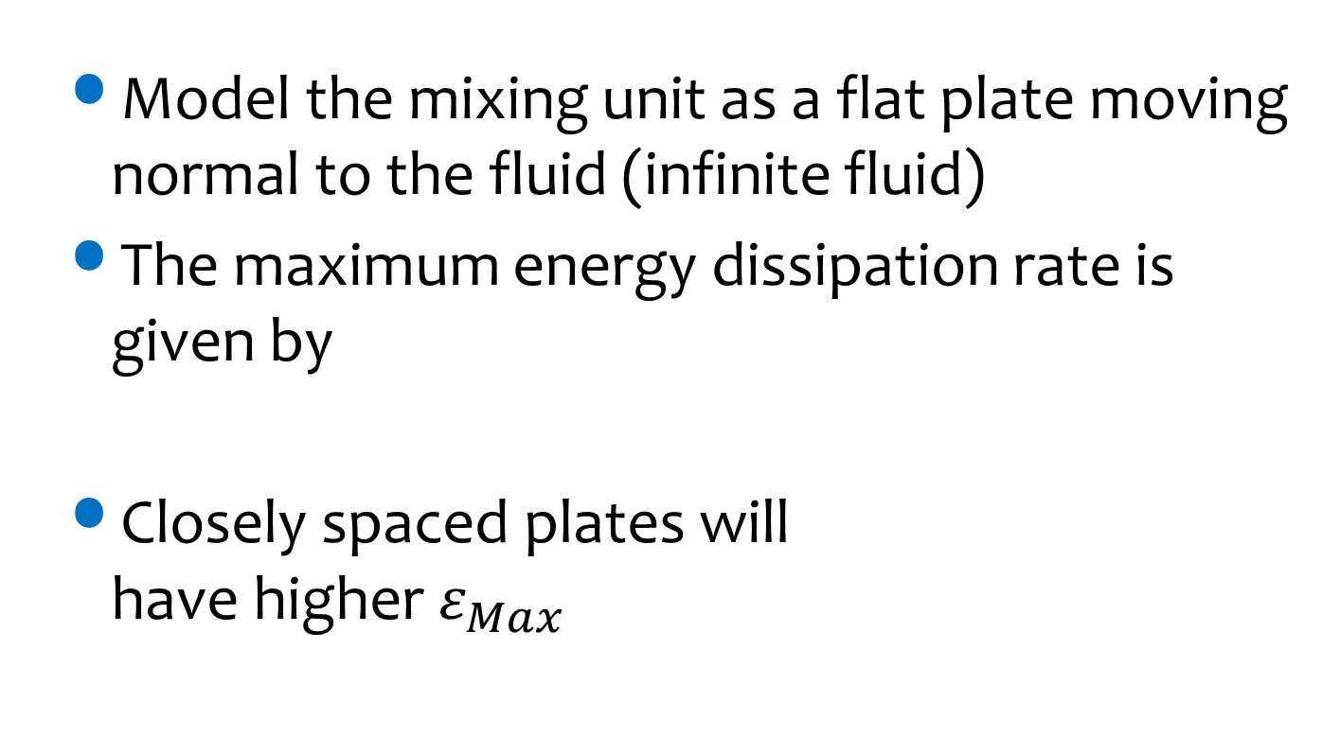
Mechanical Flocculators and Energy Dissipation Rate
Model the mixing unit as a flat plate moving normal to the fluid (infinite fluid)
The maximum energy dissipation rate is given by
Closely spaced plates will have higher $ε_{Max}$
V is relative velocity between fluid and plate

Slide 11
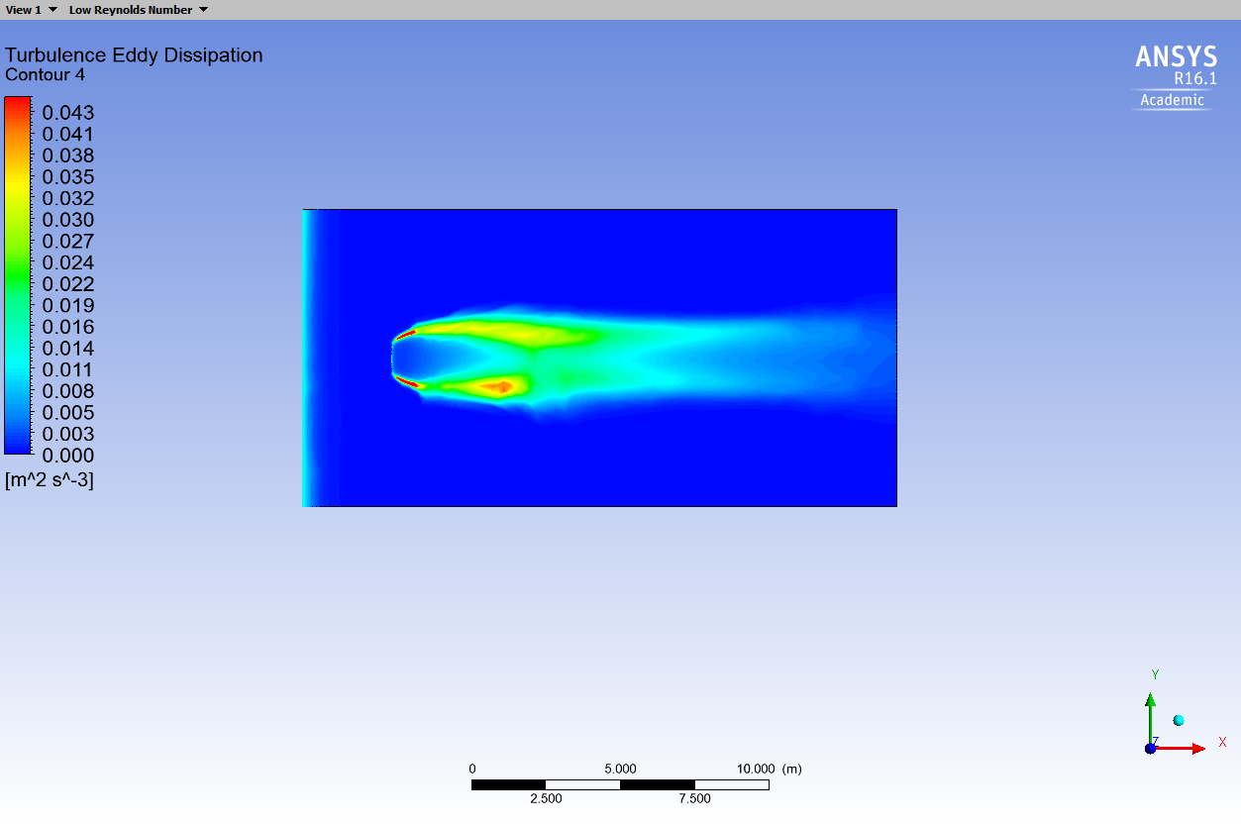
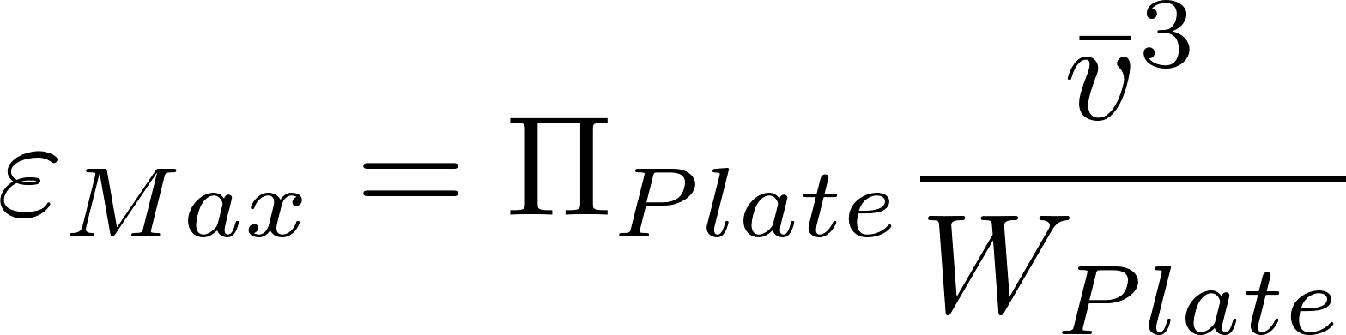
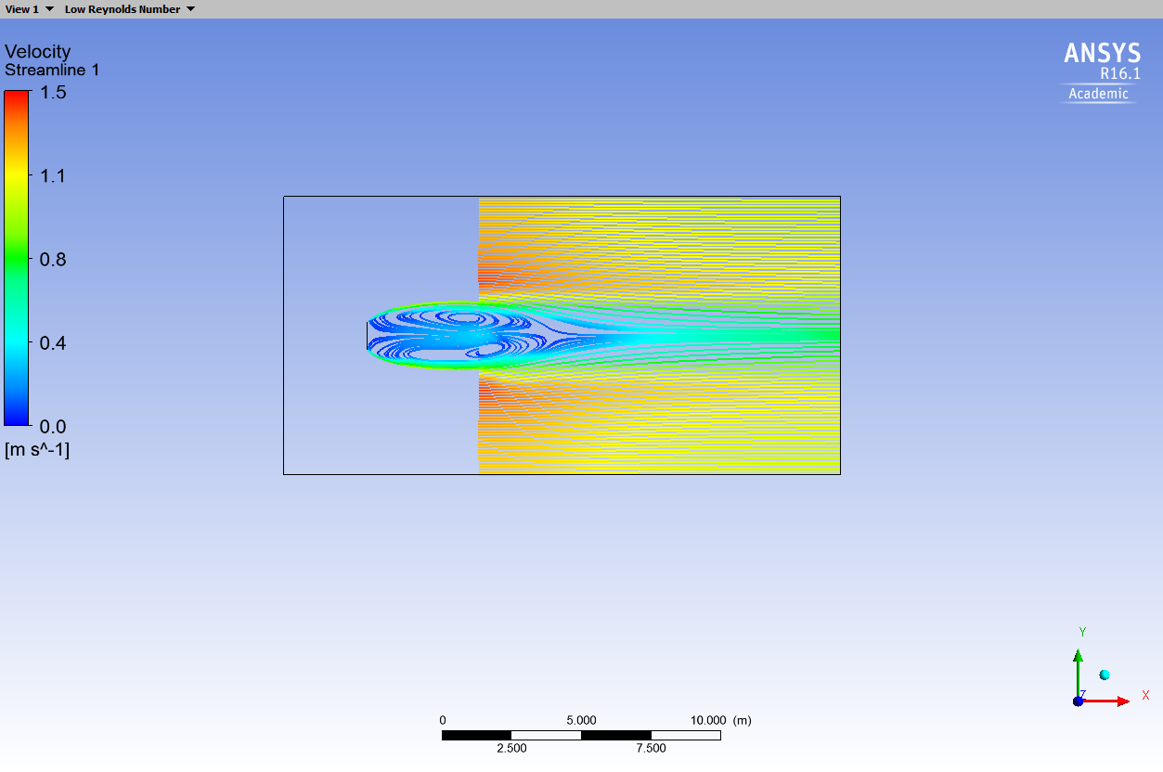
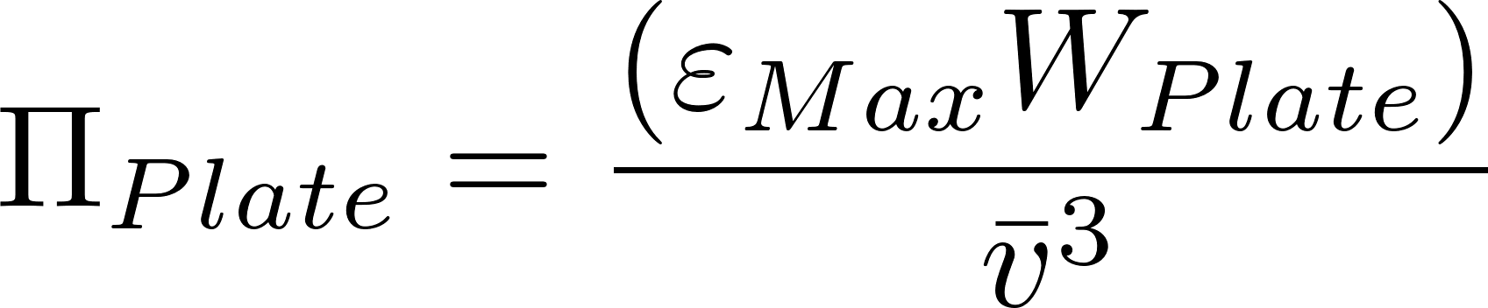
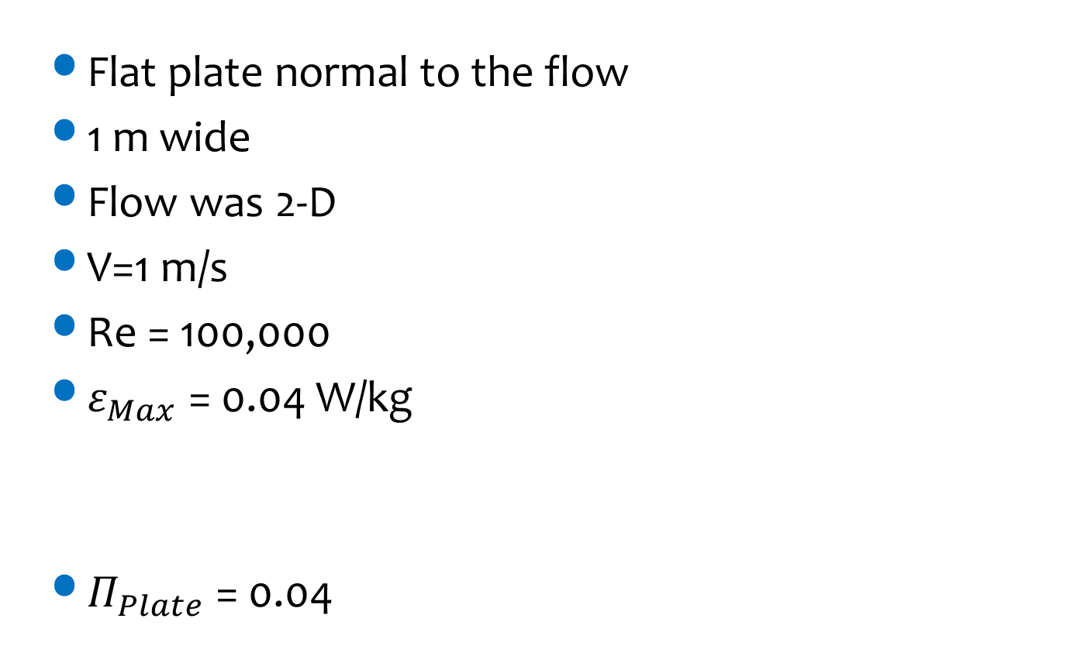
Computational Fluid Dynamics Analysis
Flat plate normal to the flow
1 m wide
Flow was 2-D
V=1 m/s
Re = 100,000
$ε_{Max}$ = 0.04 W/kg
$Π_{Plate}$ = 0.04
Energy dissipation rate
Streamlines
Notes:
Ariane Walker-Horn <avw27@cornell.edu> 2015

Slide 12


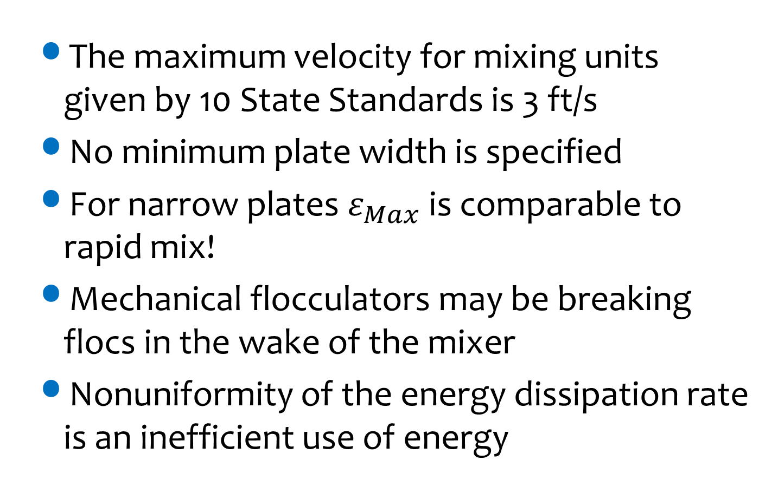
What is $ε_{Max}$ for mechanical flocculators?
The maximum velocity for mixing units given by 10 State Standards is 3 ft/s
No minimum plate width is specified
For narrow plates $ε_{Max}$ is comparable to rapid mix!
Mechanical flocculators may be breaking flocs in the wake of the mixer
Nonuniformity of the energy dissipation rate is an inefficient use of energy
http://10statesstandards.com/waterrev2012.pdf

Slide 13
Uniformity of mixing requires
“Flocculation reactors should be designed to have relatively uniform mixing intensities throughout the reactor.”
“If the mixing intensity varies considerably across the reactor, substantial breakup will occur in the portions of the reactor with the highest intensities, thereby acting against the flocculation desired.”
Benjamin and Lawler. Water Quality Engineering: Physical/Chemical Treatment Processes (page 833)

Slide 14
Mechanical Flocculators Summary
extra
Waste (a small amount of) electricity
Require unnecessary mechanical components
Have a wide distribution of energy dissipation rates (highest in the wake of the paddles) that may break flocs
Have a wide distribution of particle residence times (completely mixed flow reactors)

Slide 15
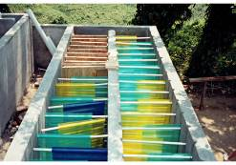
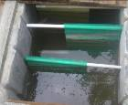
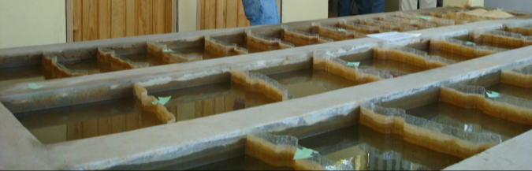
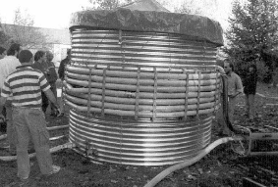
Hydraulic Flocculators
Horizontal baffle
Vertical baffle
Pipe flow (w/ orifices)
Gravel bed
Very low flows and pilot plants
A bad idea (cleaning would require a lot of work)

Slide 16

Flocculator Geometry
extra
Entrance
2 Channels
Port between channels
Exit
Lower Baffles
Upper Baffles
Notes:
planta de 50 Lps con 2 cámaras de sedimentación

Slide 17
Why aren’t hydraulic flocculators used more often?
Simple construction means that there aren’t any items that private companies (venders) can sell as specialized components
Consulting firms want to be able to pass the design responsibility off to a vender
The presumed operation flexibility of mechanical flocculators (variable speed motor driving a slow mixing unit)
Poor documentation of design approach for hydraulic flocculators (special permission required to use in the US!)
Using electricity is cool, design innovation is suspect…
Prior to AguaClara we didn’t have a design algorithm based on the fundamental physics

Slide 18
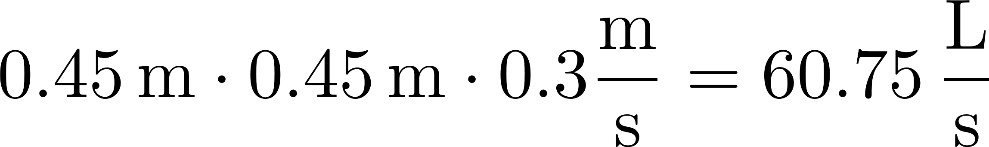
Schulz and Okun (Hydraulic flocculators)
Surface Water Treatment for Communities in Developing Countries, (1984) by Christopher R. Schulz and Daniel A. Okun. Intermediate Technology Publications
Recommend velocity between 0.1 and 0.3 m/s
Distance between baffles at least 45 cm
Water must be at least 1 m deep
Q must be greater than 10,000 m³/day (115 L/s)
Gθ of 20,000 to 150,000
These aren’t universal constants!
We need to understand the real constraints so we can scale the designs correctly
What length scale could make a dimensionless parameter?
Notes:
The velocity might be related to creating collisions between particles or preventing breakup of flocs from too much shear. In any case, velocity is not the right parameter because it isn’t dimensionless and thus it might not scale properly across a wide range of plant flow rates.
Surface Water Treatment for Communities in Developing Countries, (1984) by Christopher R. Schulz and Daniel A. Okun. Intermediate Technology Publications

Slide 19
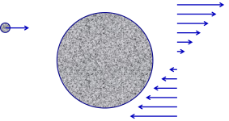
AguaClara flocculator design continues to evolve rapidly
2005 - We used conventional guidelines based on velocity gradient to design the first low flow vertical flocculator
2010 - We designed using energy dissipation rate and accounted for the nonuniformity of the energy dissipation rate (θ = 15 minutes)
2015 – We added obstacles to decrease the distance between expansions to make all of our flocculators have maximum collision efficiency (θ = 8 minutes)
2016 – Learned that particle/floc collisions are dominated by viscous shear (not by turbulent eddies)
201x –We increase the efficiency of removal of small particles (θ = 1 minute) ???????

Slide 20
Edge of Knowledge Alert
extra
Why would we ever think that the baffled flocculators invented over 100 years ago were the optimal design for flocculation? (room to improve!)
We have better coagulants now. Might that influence flocculator design?
We are only now beginning to understand the physics of fractal flocculation
We are rapidly improving the design of hydraulic flocculators based on our evolving understanding of the physics of flocculation

Slide 21
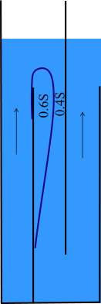
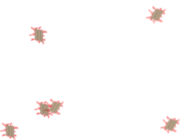
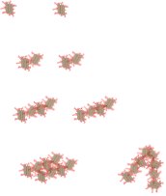
Fractal Flocculation Theory
Turbulence is caused by expansions
Particles and flocs are transported to collide with each other by turbulent eddies and over short distances by viscous shear and Brownian motion.
Flocs grow in size with each successful collision
Collisions between particles of very different sizes are not very succesful.*
*hypothesis from 2012. Might also be a limit on the sum of the diameters
Flocculation model and collision potential for reactors with flows characterized by high Peclet numbers
Monroe L. Weber-Shirk ^{, a,} and ^{Leonard W. Liona}
http://dx.doi.org/10.1016/j.watres.2010.06.026

Slide 22
Flocculation models based on geometry and stickiness of nanoparticles can predict performance
The coagulant forms sticky nanoparticles
The bond between a coagulant nanoparticle and a clay platelet is strong
The bond between two coagulant nanoparticles is weaker
Macromolecules of dissolved organic matter (DOM) cover the coagulant nanoparticles (and DOM isn’t sticky)
There is still much to learn about flocculation!

Slide 23
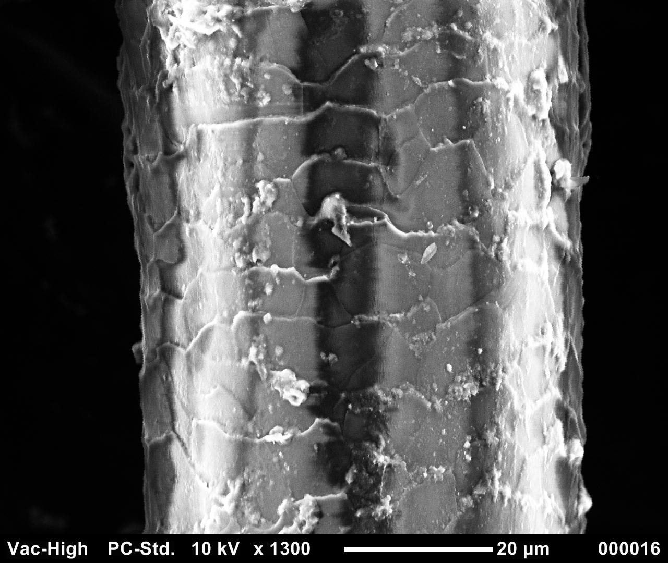
Human hair is 50 mm in diameter
clay
bacterial cell

Slide 24
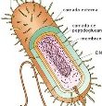
Sizes of a few particles
clay
7000 nm, 7 μm, 0.007 mm
bacteria
1000 nm, 1 μm, 0.001 mm
Nanoparticle of coagulant
90 nm, 0.09 μm
Dissolved organic matter
50 nm, 0.05 μm

Slide 25
How much coagulant should we add?
Our hypothesis:
When one clay platelet contacts another clay platelet, they will stick together if and only if there is a coagulant nanoparticle at the point of contact
clay

Slide 26
Dissolved organic matter (DOM) covers the coagulant nanoparticles
Coagulant nanoparticle
Dissolved Organic Matter (DOM)

Slide 28
How do the flocs grow?

Slide 29
The size changes produced by flocculation are dramatic
How many sequential collisions are required to make a 1 mm particle starting from 1 μm particles?
How much larger in volume is the 1 mm diameter particle?
____________
1,000
,000,000 !

Slide 30
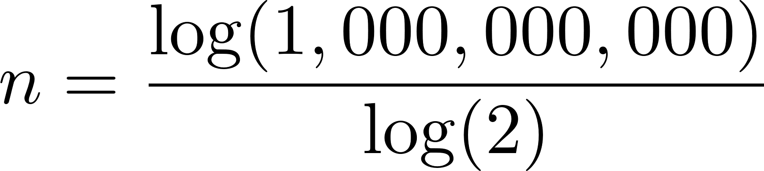
It requires many sequential doubling collisions to make a big floc
1 collision 1+1=2
2 collisions 2+2=4
3 collisions 4+4=8
4 collisions 8+8=16
Number of original particles in the floc = 2^{n}
What is n to obtain 1,000,000,000 = 2^{n}?
n=30
This assumes volume is conserved!

Slide 31
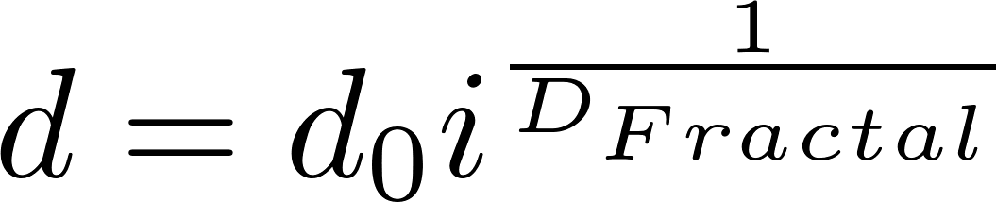
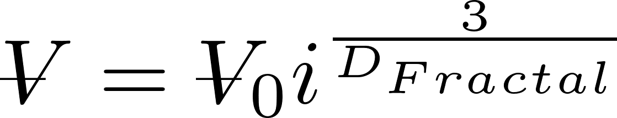
Fractals capture the idea that volume isn’t conserved
What happens to the density of a floc as it grows larger?
Floc density approaches the density of water because the floc includes water
diameter of primary particle
diameter of floc
Fractal dimension
Number of primary particles in the floc
3
If volume were conserved, what would D_{Fractal} be? ____
Is floc mass conserved? _____
No!

Slide 32
Fractal Geometry
Fractal geometry explains the changes in floc density and sedimentation velocity as a function of floc size
The fractal dimension of flocs is approximately 2.3 (based on floc measurements)
Fractal dimension is a function of the size ratio of the colliding flocs
Further research to quantify the fractal dimension in flocculation is needed
Notes:
Adachi Wat. Res. Vol. 31, No. 3, pp. 449~54, 1997

Slide 33
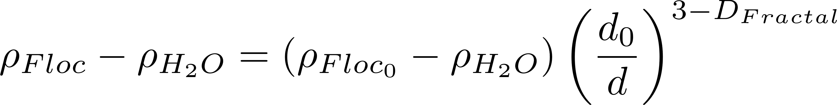
Buoyant Density of Flocs
Will these flocs settle faster than the primary particles?
Notes:
Here we assume that the primary particle (clay plus coagulant) is 1 micrometer in diameter.
The assumption is that we are starting with clay at 2650 kg/m^3.

Slide 34
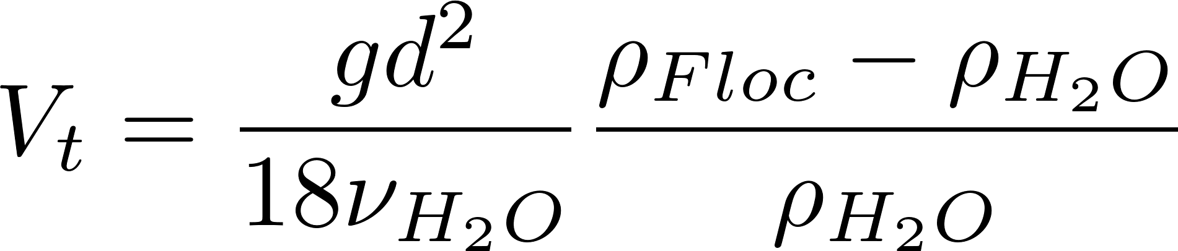
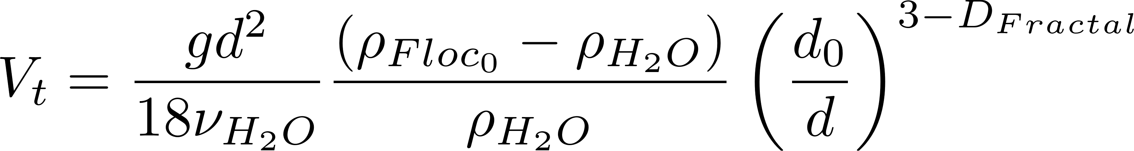
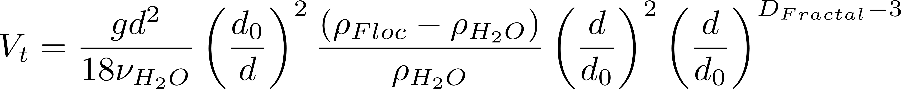
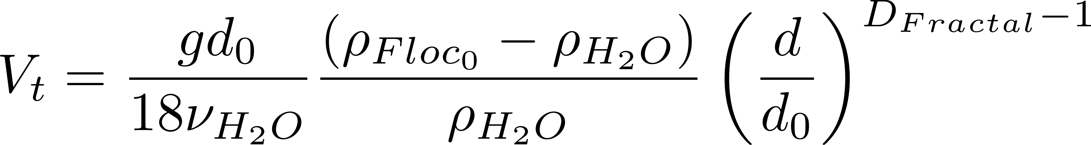
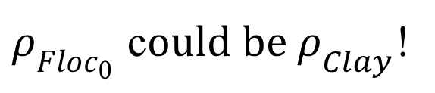
Fractal Terminal Velocity Equations
Buoyant density
Viscous flow terminal velocity
Algebra!
$ρ_{Floc_{0}}$ c$ould be ρ_{Clay}$!

Slide 35
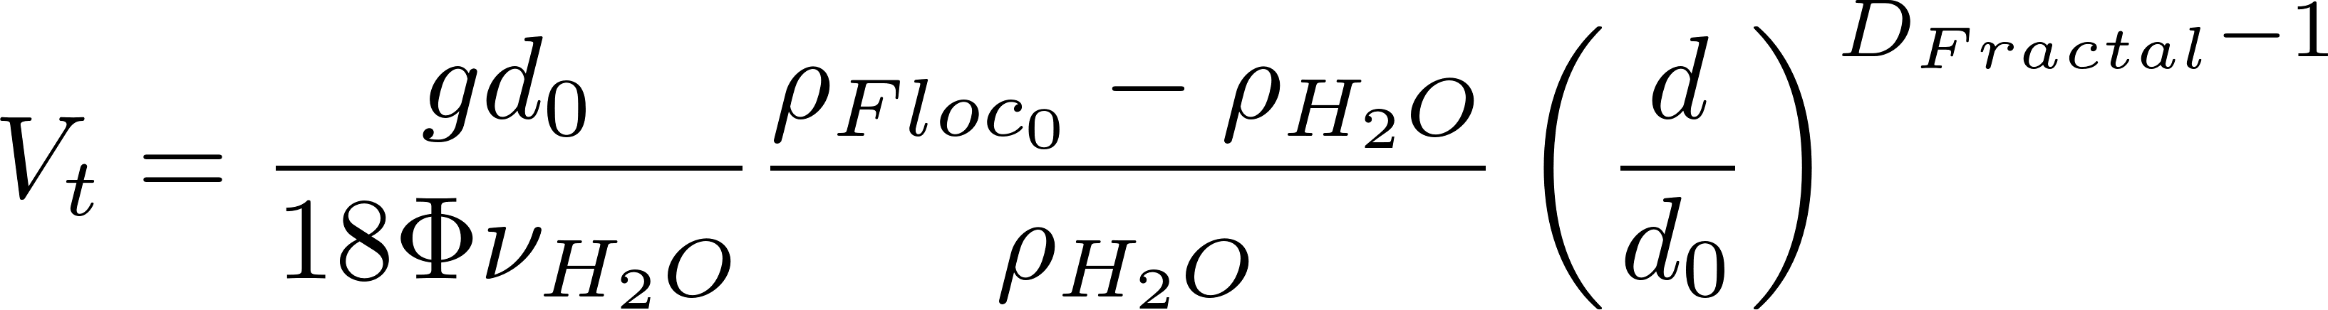
Floc Terminal Velocity
Laminar flow
Upflow velocity for floc blankets
Capture velocity for AguaClara plate settlers
Why flocculation is necessary!
1 μm
D_{Fractal} = 2.3 and d₀ = 1 μm
shape factor for drag on flocs
The model takes into account the changing density of flocs
Notes:
The shape factor adjusts the coefficient of drag for non spherical geometry and according to Tambo has a value of 45/24 for flocs (Tambo et al., 1979). This value is probably not yet well characterized. In any case it is expected to be order 1 because it is a correction to the drag coefficient.
All fractal dimensions greater than one are expected to increase the terminal velocity as the floc diameter increases.
Both floc blanket upflow velocity and plate settler capture velocity are AguaClara current design values, but are not optimized.

Slide 36

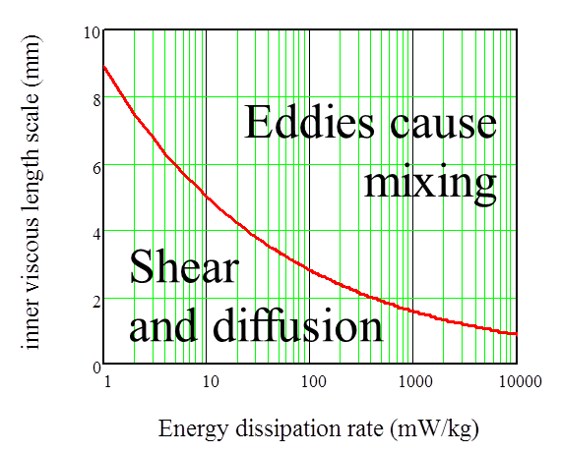
Collision Model of the Flocculation Process
The relative velocity between flocs is set by viscous shear because their separation distance is less than the inner viscous scale
The time required per collision is a function of the relative velocity between flocs, the average separation distance between flocs, and the floc size
In the next slides we will explore how to characterize collision time for flocs
We will assume that collisions occur between similar sized flocs. There is some evidence that flocs of very different diameters don’t attach when they collide. Or it may be that any collisions with large flocs are unsuccessful

Slide 37
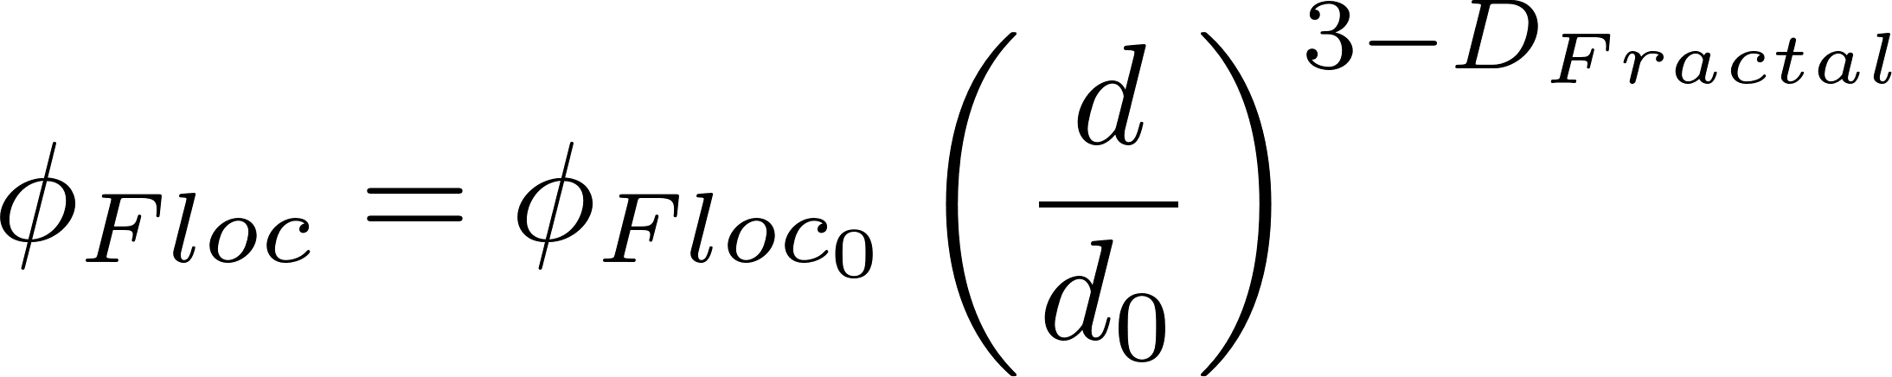
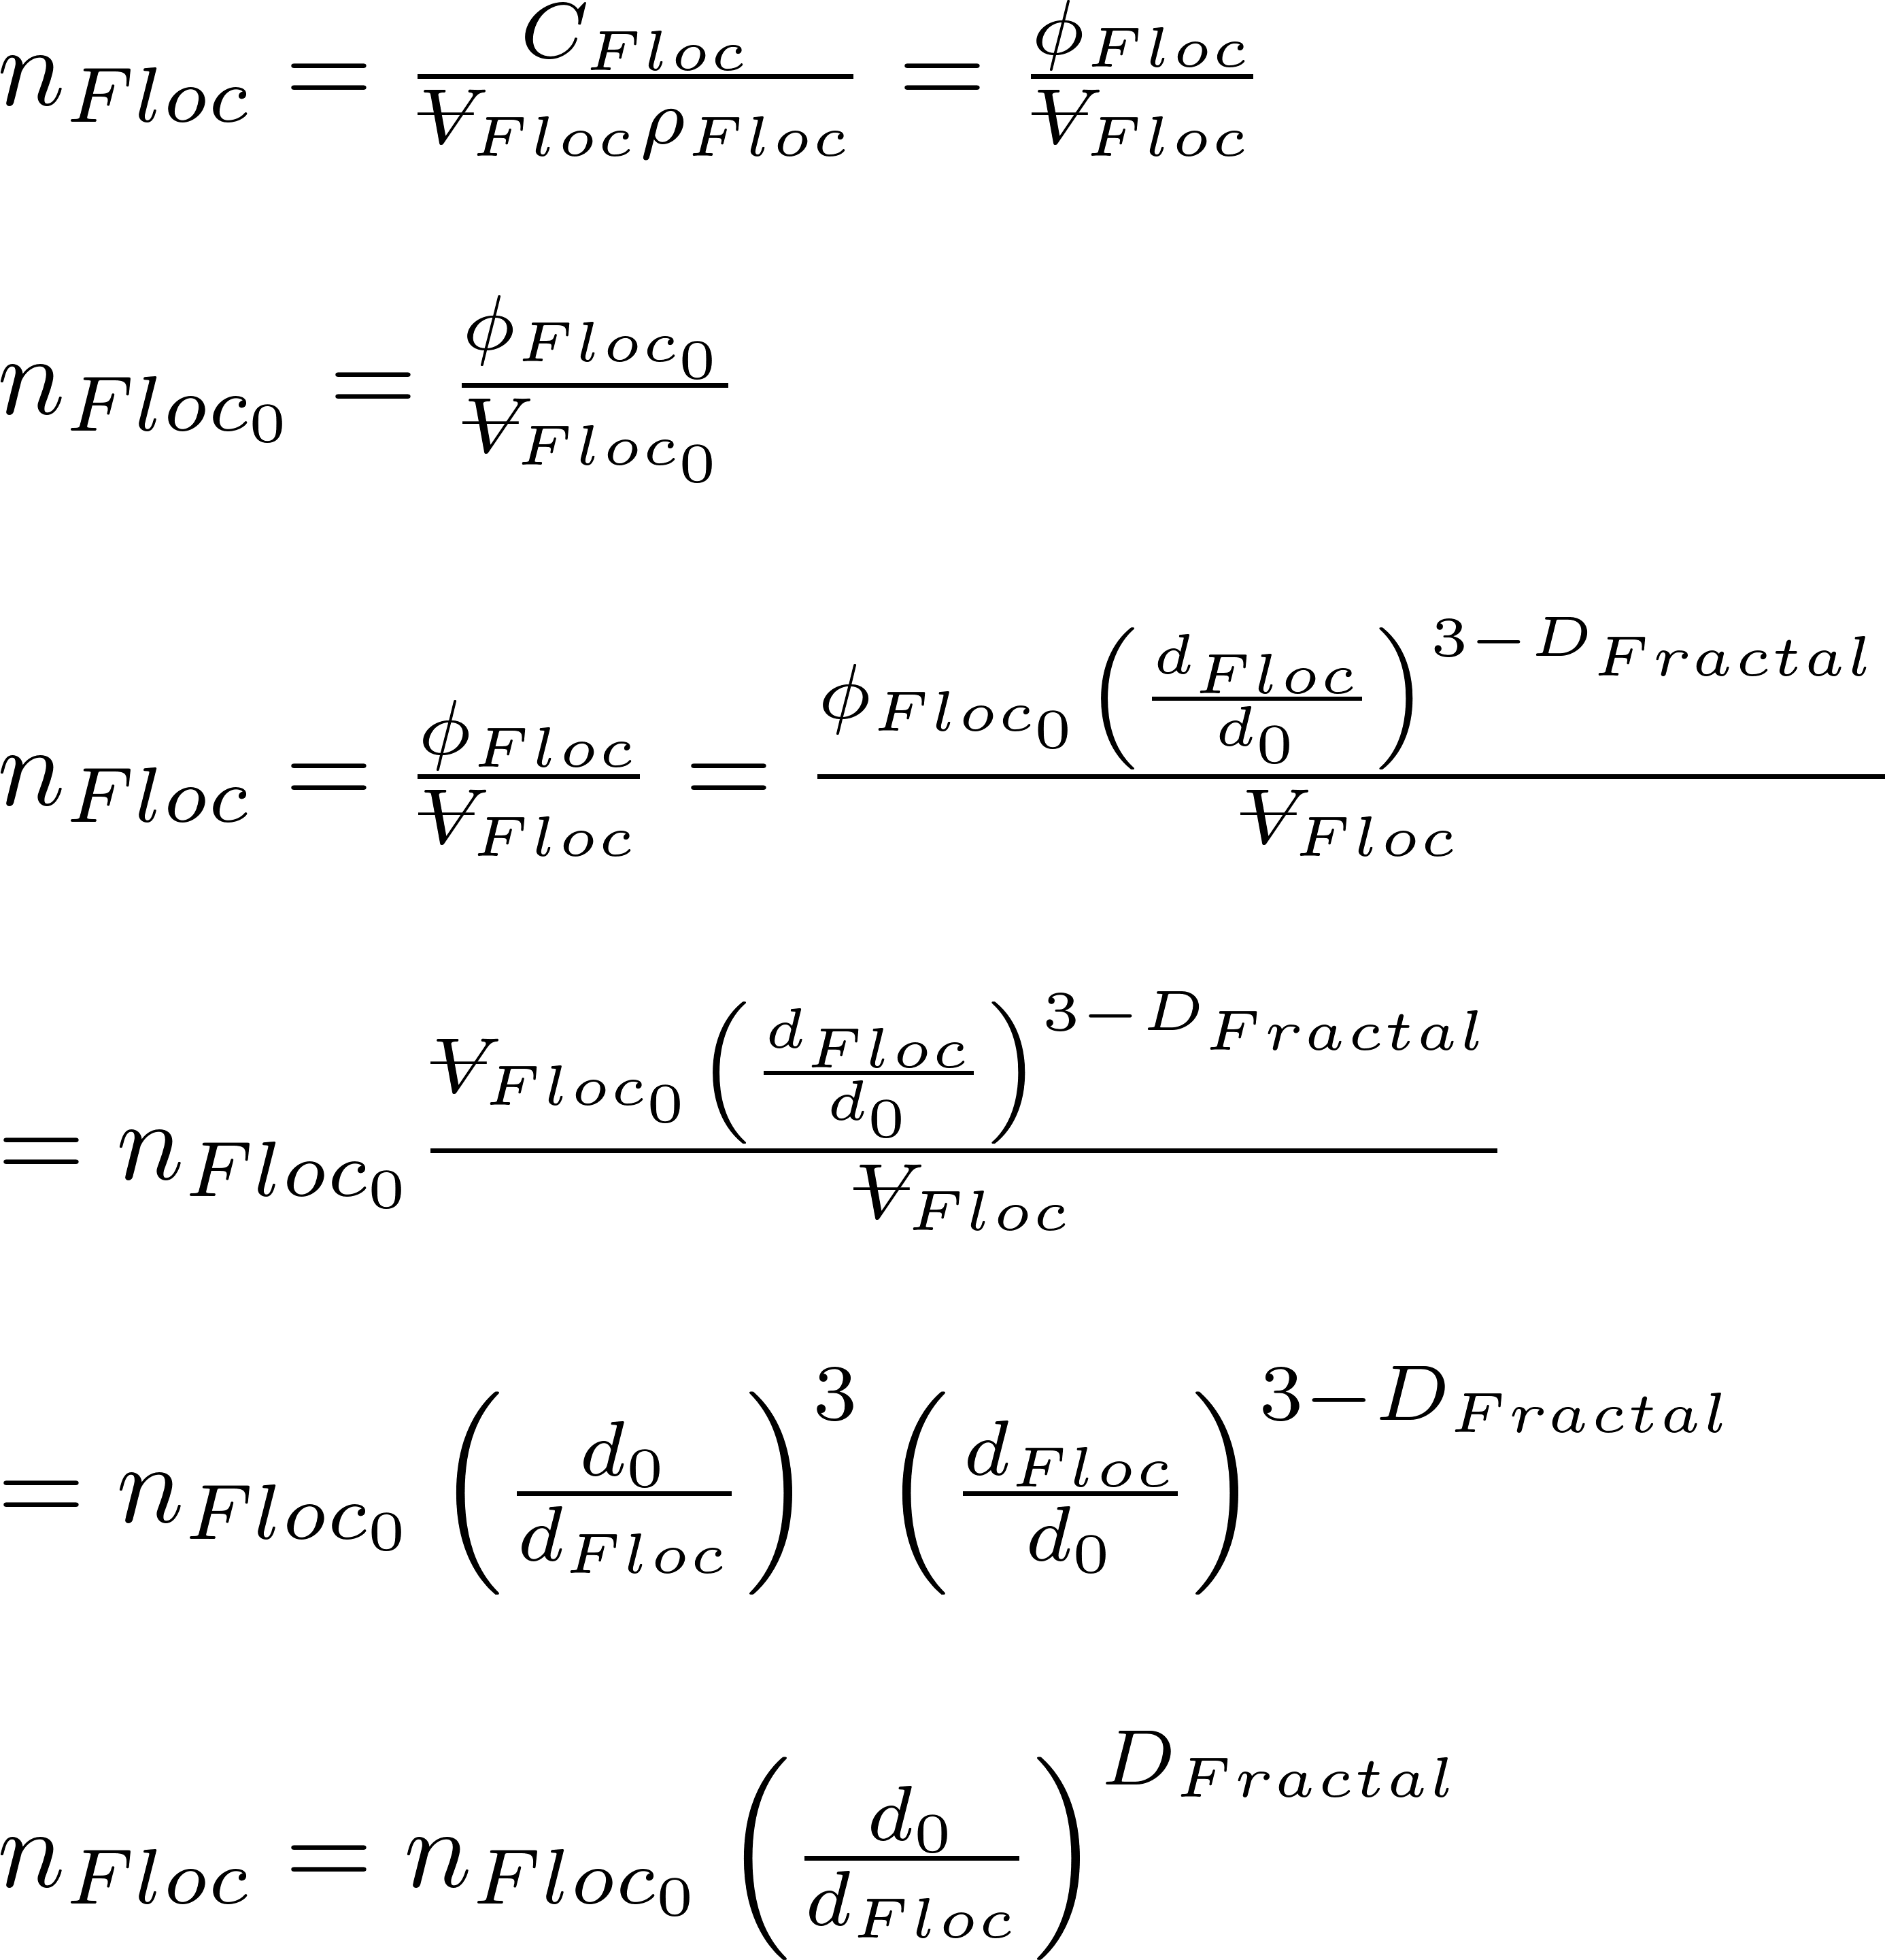
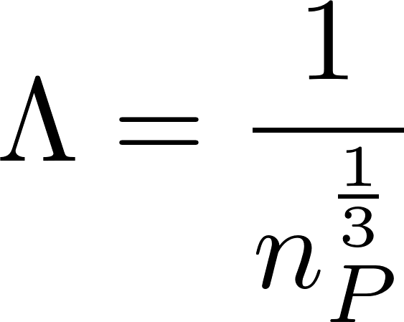
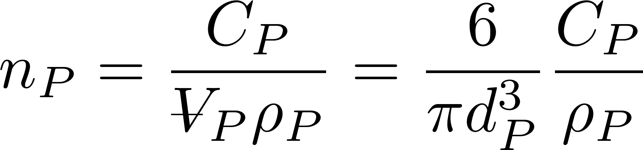



Average distance between particles is the cube root of the volume occupied (Λ)
extra
The average volume of water “occupied” by a particle!
Need to know number of particles per volume (n_{P})
The number of flocs decreases as the flocs grow in size

Slide 38


Comparison of classic and hypothesized collision models
Classic model: transport and mixing at length scales larger than the diameter of the particle do not influence collisions – therefore slow, long, straight walk toward a collision
Hypothesized model: fast random walk clearing volume of fluid equal to volume occupied followed by slow, short, straight walk toward a collision*
* Edge of knowledge

Slide 39

Classic Models: Relative velocity scales with diameter

Slide 40
Hypothesis: Relative velocity scales with separation distance
Target
Notes:
Why is the path chaotic?
What is the relative velocity?
How far does the particle need to travel before there is a collision?

Slide 41
Model assumption differences are about the relative velocities
Classic particle collision models assume that the average relative velocity of two particles is set by the length scale of the diameter of the particles regardless of their separation distance
We hypothesize that the majority of the transport time is spent in a long random walk with relative velocities based on the average particle separation distance (Λ)*
* Edge of knowledge

Slide 42



Proposed (Λ) Long Range Transport Hypothesis*
At all times there exists a differential VOLUME of fluid that will transport any particle with its center located within that differential VOLUME to a collision of the particle and collector between and
The time required for that final transport to a collision is
Long range transport delivers the particle to the differential volume for the final slow transport to the collision
Next… characterize the time for the long range transport
* Edge of knowledge
Notes:
This is not clear. There seems to be an important assumption about this being a volume rather than an area to take into account the fact that flocs are 3 dimensional and not 2 dimensional. It seems that conventional collision models assume that particles are 2 dimensional.

Slide 43






How much water is cleared (filtered) from a floc’s perspective?
Volume cleared is proportional to a collision area defined by a circle with diameter = sum of the particle diameters
Volume cleared is proportional to time
Volume cleared is proportional to the relative velocity between flocs

Slide 44













Use dimensional analysis to get a relative velocity
Velocity scales with
Λ is separation distance
Assume linear velocity gradient
Velocity gradient
dimensions
Notes:
The length scale is the average separation distance of the flocs

Slide 45









Collision rates for the two assumptions
t_{c} is average time per collision
Relative velocity
Time for one collision
$N_{c}$ is number of sequential collisions that result in aggregation.
α is probability of attachment given a collision
Notes:
Find the time to clear the volume occupied by one floc.
Then we need to find the average relative velocity of the two flocs based on their average separation distance.

Slide 46








Collision Rate and Particle Removal
Track fraction of small particles if all particles are active
Geometry
Track small particles as flocculation progresses with small particle number concentration, n_{p}, as our master variable (track settled NTU)
d.T is the characteristic diameter of the actively growing flocs
First order conversion of small particles to flocs with respect to the number of collisions
Small particles are converted into large flocs by collisions with small particles
Tracking residual turbidity!

Slide 47



















Integrate
Particle size and density is assumed constant because the model is tracking the small particle population that won’t be removed during sedimentation.
What is the p function?

Slide 48
pC*: A dimensionless measure of removal efficiency
Sloppy parlance… log removal
What is the target effluent turbidity for a water treatment plant?
What is pC* for a water treatment plant treating 300 NTU water?
What is required effluent turbidity?
How many orders of magnitude reduction?
Notes:
Goal is low turbidity settled water. Turn ALL small particles into flocs that are large enough to be removed by sedimentation (80 micrometers in diameter).

Slide 49









We can test the collision models with laboratory data
Data will converge if we choose the right dimensionless grouping
Plot performance as a function of this dimensionless group

Slide 50

Coiled Tube Flocculation Residual Turbidity Analyzer
Dr. Karen Swetland Dissertation research
Notes:
Here we plotted the residual turbidity, the turbidity of the water after settling, against the coagulant dose. We noticed that when we used a log-log plot, there was a linear trend in the data. So we explored further.

Slide 51



Diameter Scaling
$$k=1$$
$$D_{Clay}=7 μm$$
$$D_{Coag}=20 nm$$
Notes:
Analysis by William Pennock, 2016
This clay size may be larger than realistic and the nanoparticles may be smaller than what was produced by the granular PACl used by Karen.

Slide 52



Separation Distance Scaling
$$k=0.05$$
$$D_{Clay}=7 μm$$
$$D_{Coag}=20 nm$$

Slide 53
Relative velocities appear to scale with average separation distance
These results appear to be different than classic particle collision models
There might be a confounding assumption that leads to these surprising results
Big flocs are useless
Small flocs disappear at a rate proportional to the number of their collisions
?

Slide 54


Floc model for viscous dominated collisions
Particle diameter
A function of fractional surface coverage of particle by coagulant
Rate constant (model fitting parameter)
Flocculation time
Velocity gradient
Initial particle spacing

Slide 55








Model predictions?
Flocculator must be designed for target settled water turbidity

Slide 56




Slide 57

Predictions for required Gθ also suggest that Λ scaling is correct

Slide 58





Track surface area to assign probabilities to collisions
Fraction of clay surface area coated by coagulant (this includes coagulant that is coated with humic acid)
Fraction of coagulant surface area coated by humic acid
Fraction of clay surface area that isn’t coated by anything
Fraction of clay surface area that is coated by clean coagulant
Fraction of clay surface area that is coated by coagulant that is coated by humic acid

Slide 59

There are 3 possible initial points of contact that can lead to attachment
The probability of a clay surface colliding with a PACl surface is equal to twice the probability that the first surface is clay and the second surface is the PACl surface of a PACl-HA nanoaggregate
The probability of a PACl surface colliding with a PACl surface
The probability of a PACl surface colliding with a HA surface

Slide 60
The flocculation model is far from complete
Doesn’t predict decreasing performance at high coagulant dosages
Likely that coagulant-coagulant bonds are weaker than coagulant-clay bonds and we don’t yet have that effect in the model
Doesn’t describe floc formation when the dissolved organics concentration is so high that bonds are significant
Doesn’t describe effects of sedimentation tank design

Slide 61
4 major assumptions of the floc model
Long range transport velocity to a collision scales with the average separation distance of the particles
Relative velocities between particles are dominated by viscous shear (not inertia)
Separation distance is smaller than inner viscous scale
Collisions with large flocs don’t result in attachment
Plug flow!

Slide 62


Particle collisions appears to be dominated by viscous shear
inertial
viscous
Particle separation distances are less than the viscous length scale
Notes:
http://dimotakis.caltech.edu/pdf/Dimotakis_JFM2000.pdf (see equation 20 for factor of 50)
Assume clay size is 4 microm.
Rapid mix exploration.xmcd

Slide 63






What does Gt mean?
y
y
velocity
Displacement in time t
$$v_{r}$$
$$Λ$$
u
x
$$L_{Deformation}$$
Definition of velocity gradient
Find relative velocity between flocs separated by distance $Λ$
The relative distance traveled due to fluid deformation is proportional to time
A Gt of 1 means that the particles have a relative displacement equal to their separation distance

Slide 64
Fractal Flocculation Conclusions
It is difficult to flocculate to a low residual turbidity because the time between effective collisions increases as the number of particles and non-settleable flocs decreases
Particles can’t attach to full size flocs
Perhaps because of high differential velocities at the moment of impact
We have an unpublished model that predicts settled water turbidity after a flocculator (assuming no flocculation in the sedimentation tank)
The model is an approximation!

Slide 65
What is the model missing?
The model doesn’t include any particle aggregation that occurs in the sedimentation tank
Residence time in the sed tank is long and energy dissipation rate is low
Filtration in the sed tank (especially if there is a floc blanket) may be important
It assumes all nanoparticles interact with clay and not with dissolved organic matter or fluoride or …

Slide 66
Review
Why is it that doubling the residence time in a flocculator doesn’t double pC* for the flocculator?
Why does increasing initial turbidity decrease the initial time between collisions?
Which terms in the model are determined by the flocculator design?
The model assumes plug flow!

Slide 67

Surface coverage (Γ) of clay by coagulant precipitate
extra
In our modeling work we didn’t cover how to calculate what fraction of the clay surfaces are coated with coagulant. The following slides are the equation heavy derivation of that coverage. We assume coagulant precipitate has some characteristic diameter when it sticks to the clay and that the clay can be represented as a cylinder. We also assume that the coagulant sticks to everything including reactor walls. The coagulant approaches the clay surface randomly and thus accumulates in a Poisson distribution. The random bombardment means that some coagulant is wasted in double coverage of previously covered clay.
It is possible that the number of successful collisions is not simply directly proportional to surface coverage. It isn’t clear why surface coverage greater than about 50% would be of any benefit given that nanoparticles likely attach more strongly to clay than to nanoparticles.

Slide 68







Surface coverage (Γ) << 1 and small loss to reactor walls
extra

Slide 69





Surface coverage (Γ) << 1 and small loss to reactor walls
extra

Slide 70


Even with simplified assumptions, including Γ complicates the analysis
extra

Slide 71

Solving for residual turbidity results in a complicated equation
extra

Slide 72







Floc Model Equations for Γ
extra
Surface area of clay divided by total surface area of clay + reactor walls
Surface area to volume ratio for clay normalized by surface area to volume ratio for a sphere

Slide 73


Ratio of clay surface area to total surface area (including reactor walls)
extra

Slide 74


Poisson distribution and coagulant loss to walls combined to get surface coverage
extra

Slide 75



Poisson distribution and coagulant loss to walls combined to get surface coverage
extra
The surface coverage is reduced due to stacking (which is handled by the Poisson distribution) and by the loss of coagulant to the reactor walls.
loss of coagulant to the reactor walls

Slide 76





Clay platelet geometry
extra
Model clay as cylinder with height and diameter
D.Clay is the diameter of a sphere with equal volume as the clay platelet
D.ClayPlatelet is the diameter of a cylinder given ratio of height to diameter and equal volume spherical diameter

Slide 77



Clay platelet geometry
extra

Slide 78




Surface coverage of clay
extra
If you neglect wall loses

Slide 79



Solving for Coagulant Dose
extra
Coagulant dose is inside coagulant volume fraction
Solve for dose…
Given a target residual turbidity, solve for required Γ, then solve for coagulant dose

Slide 80
Loss of clay to reactor walls
extra
Loss of coagulant to reactor walls can dominate for low turbidities and small reactors. For the EStaRS in India treating 5 NTU water and injecting coagulant into 7.5 cm pipes the clay only gets 23% of the applied coagulant!
There may be a way to design a larger contact chamber for the coagulant to reduce losses to the walls.
Notes:
FractalFlocModel.xmcd (Mathcad 15 files)

Slide 81
Effect of stacking and wall loss in a 10 cm diameter flocculator with 20 NTU
extra
Stacking due to random bombardment of the clay surface with coagulant nanoparticles. Stacking becomes significant for high surface coverage. Wall losses also cause a significant reduction in clay surface coverage.

Slide 82









Slow velocity through the annulus, Fast velocity at separation Λ
Find the average shear on the floc surface based on the drag at low Re
The
Shear at the floc surface related to velocity gradient at the floc surface
The velocity gradient is steeper at the surface of the floc than it is further from the floc.

Slide 83





CMFR model

Slide 84



Small particle diameter cancels out!
Flocculator must increase in volume by factor of 4.6 to reduce turbidity by factor of 10

Slide 85





Slide 86






Comparison with Karen’s model
Karen’s empirical model
Floc model
neglecting initial conditions
Use phi notation
Prepare to convert to initial phi
The equations are NOT the same

Slide 87
Why might floc collision fail if the flocs are of very different sizes?
Tangent and rotational velocities cause shear and unzipping of bonds between particles of different sizes
Tangent velocity is proportional to the sum of the diameters of the particles
Flocs reach a terminal size based on a balance of the adhesive force of the bonds and the shear force that tends to tear them apart
Once a floc has reached its terminal size any further collisions are unsuccessful
Very few small particles get close enough to a big floc to collide

Slide 88
Collision of two small flocs
Tangent velocities of the particles surfaces at collision is similar in magnitude to the normal velocity

Slide 89

Collision of a small floc with a large floc
Tangent velocities of the approaching particle surfaces increase as size of either particle increases
Bonds formed on impact are unzipped due to rotation and high tangent velocities (perhaps a maximum relative velocity?)

Slide 90





Collision of a small floc with a large floc
Translational velocity of small particle, $V_{t_{2}}$
Rotational velocity of top of large particle, $V_{r_{1}}$
Rotational velocity of bottom of small particle,$V_{r_{2}}$
2
1
Velocity gradient, G

